Slide 1

An Analysis of World Universities Ranking
2011 - 2023
APRIL 2023
AngelHack Challenge
By
Salisu Ali

Slide 2
Introduction
The dream of every student is to study in one of the best universities in the world as this affect the quality of education one gets and the impact of that education in the society.
Some universities are perceived as the best, but are they really the best? If so, what are they really good at.
In this analysis, I’ll dissect the Times Higher Education World Universities Rankings to find out which universities are the best. This involves ranking them, not just on overall score, but also based on certain criteria's which include:
Teaching
Research
Citation
Industry Income
International Outlook
I’ll also compare the best of the best, to the best ranked universities in each of these criteria’s.

Slide 3
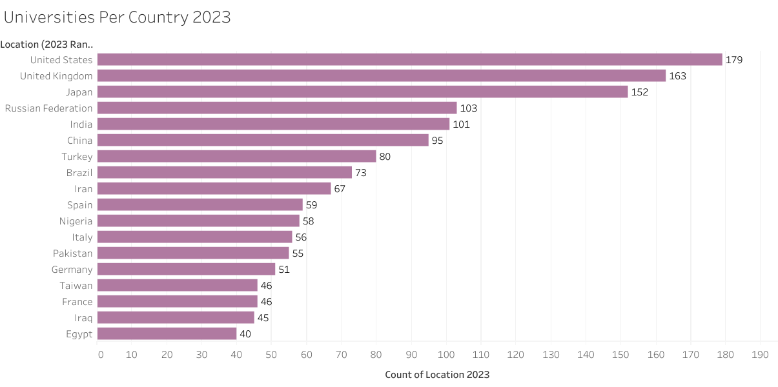
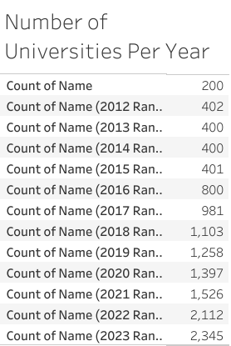
The World University Rankings
The Times Higher Education World University Rankings is the most diverse university rankings to date.
The 2023 Rankings has 2,345 universities from 104 countries. The top 3 being:
United states with 179 universities
United Kingdom with 163
Japan with 152 universities

Slide 4
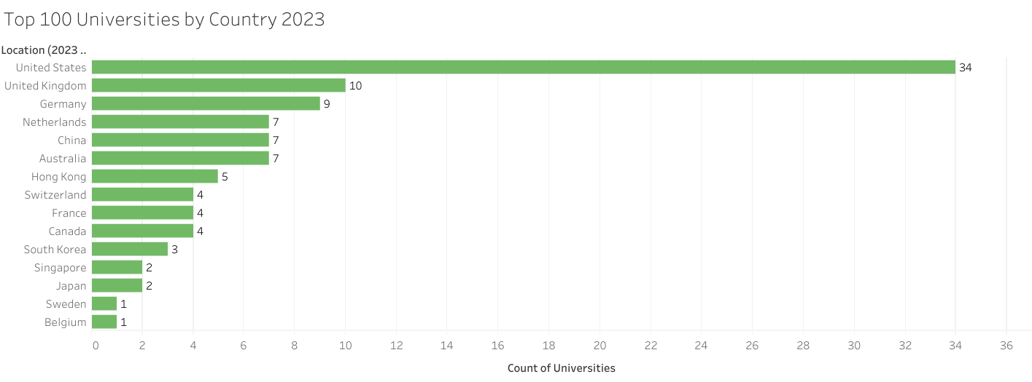
Quality, Not Quantity
Top 100 Universities in 2023 Ranking:
Came from 15 countries
United States has the highest, 34 universities, United Kingdom 10 universities, followed by Germany with 9 Universities
North America, Asia, Europe, Australia all have representatives in top 100
South America, Middle East and Africa has no university that made it to the to 100

Slide 5
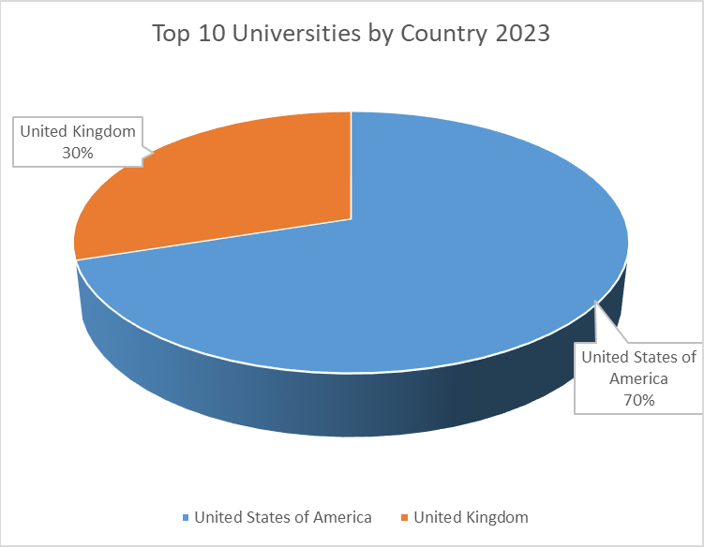
Scaling Down further
The Universities That made the top 10 rankings in 2023:
7 universities from the United States
3 Universities from the United Kingdom

Slide 6
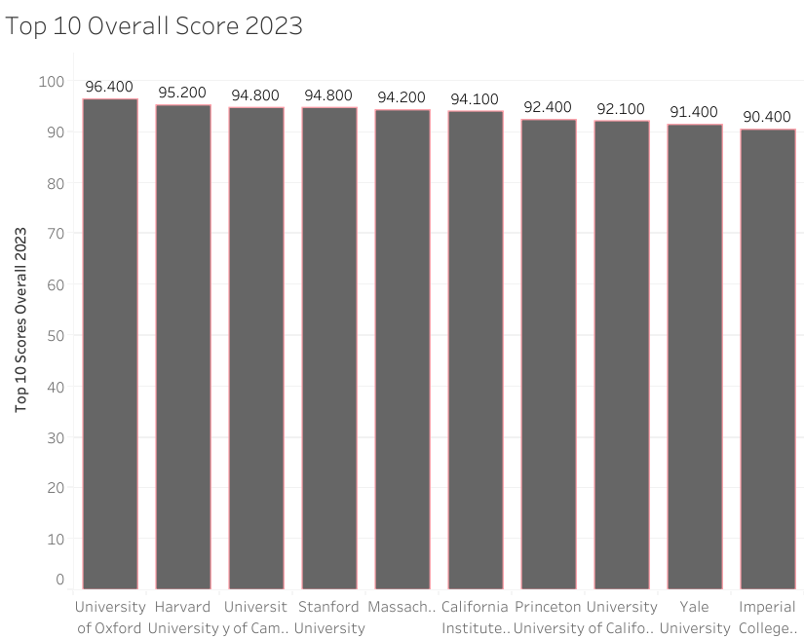
Which Ones Made Top 10
They are :
United States:
Harvard University - 2nd
Stanford University – 4th
Massachusetts – 5th
California institute of Tech – 6th
Princeton University – 7th
University of California – 8th
Yale University – 9th
United Kingdom:
University of Oxford – 1st
University of Cambridge – 3rd
Imperial College – 10th

Slide 7
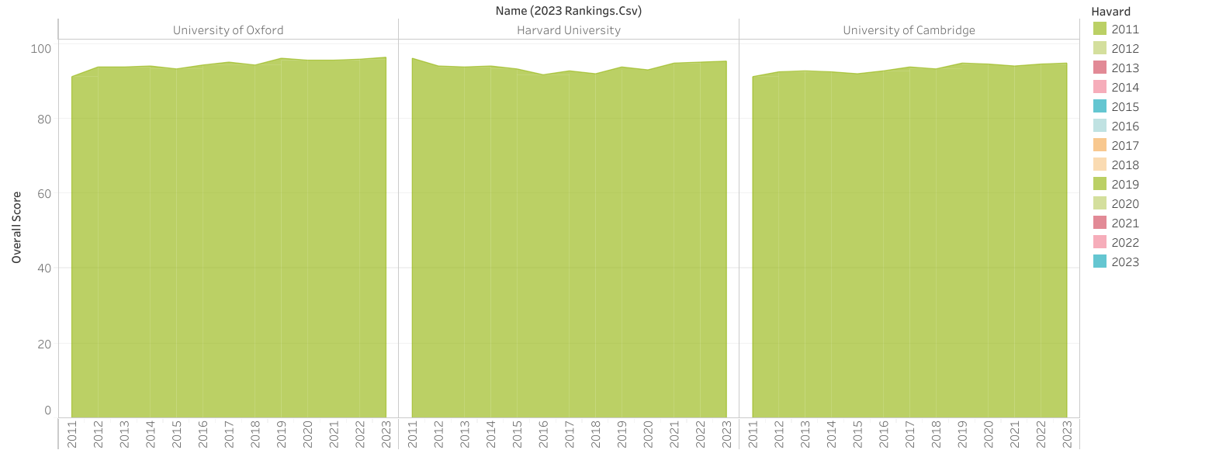
2023 Top 3 Universities Rankings from 2011 - 2023

Slide 8
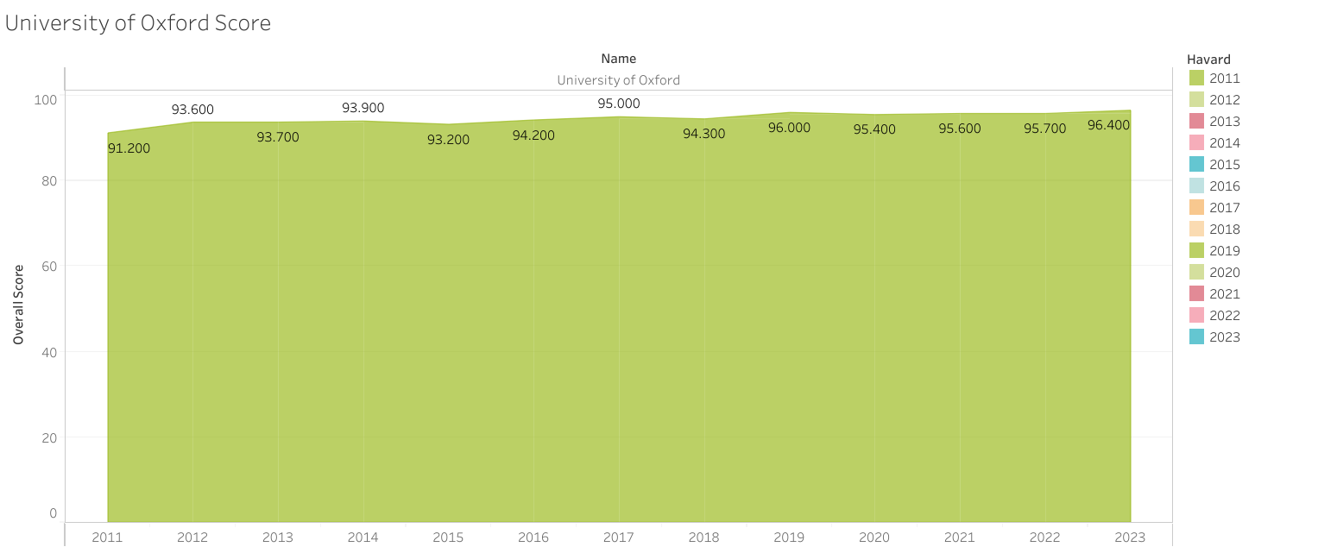
A Closer Look at University of Oxford
Lowest Ranking: 2011
3 years of positive growth
Dipped in 2015
2 years of positive growth
Dipped in 2018
1 year of positive growth
Dipped in 2020
Has been on Positive growth since then with 2023 ranking being the best.

Slide 9
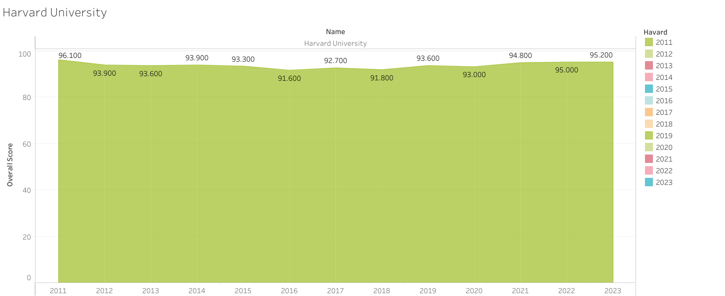
A Closer Look at Harvard University
Best Ranking: 2011
Dipped for 2 years
Positive growth in 2014
Dipped for 2 years
Positive growth in 2017
Dipped in 2018
Positive growth in 2019
Dipped in 2020
Has been on Positive growth since then.

Slide 10
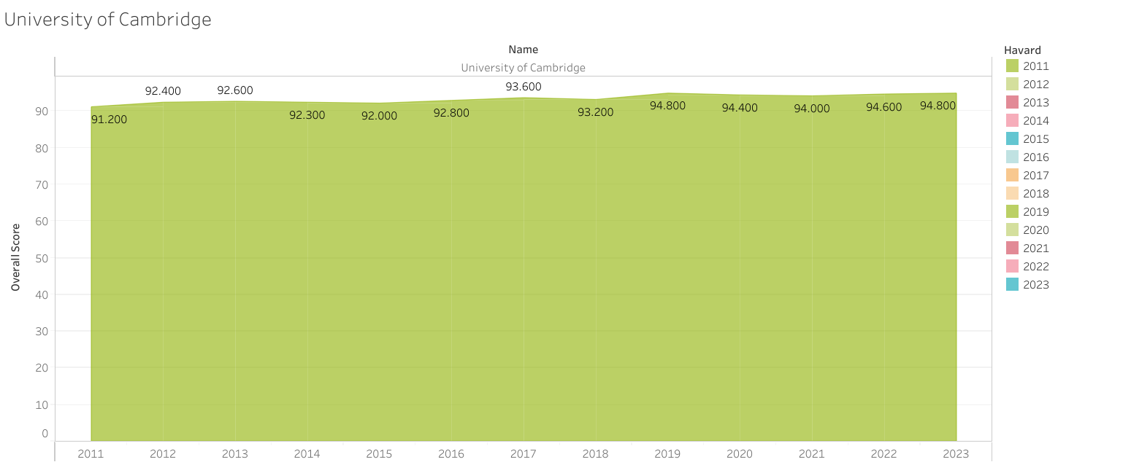
A Closer Look at University of Oxford
Lowest Ranking: 2011
2 years of positive growth
Dipped in 2014 and 2015
2 years of positive growth
Dipped in 2018
1 year of positive growth
Dipped in 2020 and 2021
Has been on Positive growth since then with 2023 ranking being the best.

Slide 11
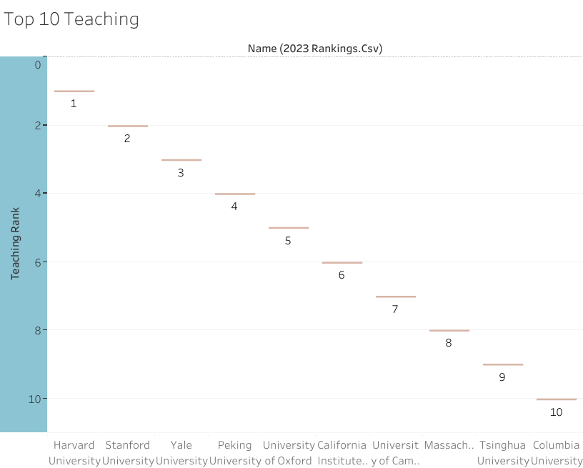
Ranking Criteria: Teaching 2023
This give a good indication of the prestige, facilities and resources of the teaching environment, which would have a direct impact on the student
The top 10 universities in terms of teaching include:
6 from United States – North America
2 from United Kingdom - Europe
2 from China - Asia

Slide 12
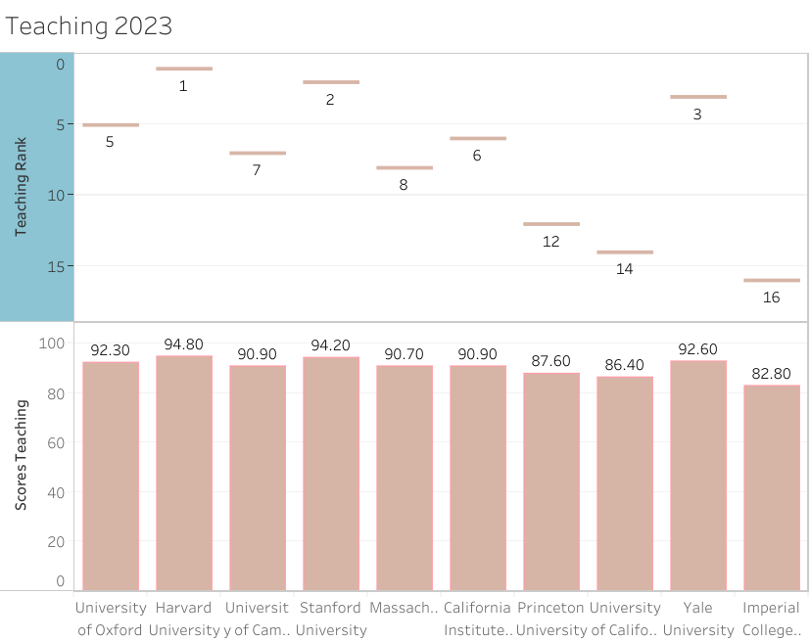
How Did TOP 10 Overall Rank: Teaching
United States:
Harvard University – 1st
Stanford University – 2nd
Massachusetts – 8th
California institute of Tech – 6th
Princeton University – 12th
University of California – 14th
Yale University – 3rd
United Kingdom:
University of Oxford – 5th
University of Cambridge – 2nd
Imperial College – 16th

Slide 13
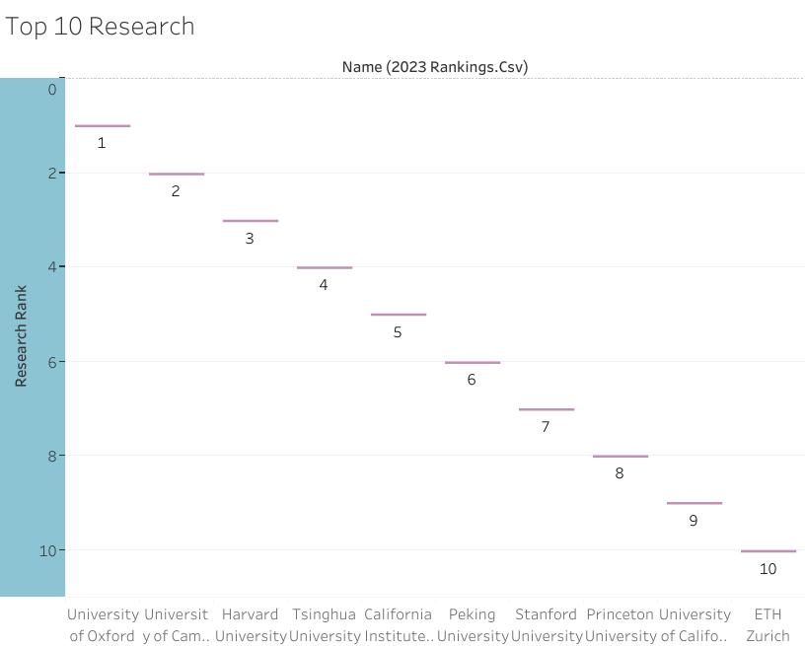
Ranking Criteria: Research 2023
An opportunity to learn from leading researchers, will benefit one both intellectually and practically. One will learn not just about the research they are doing, but also pick up essential intellectual skills that will serve one’s whole life.
The top 10 universities in terms of Research include:
5 from United States – North America
2 from United Kingdom - Europe
2 from China - Asia
1 from Switzerland - Europe

Slide 14
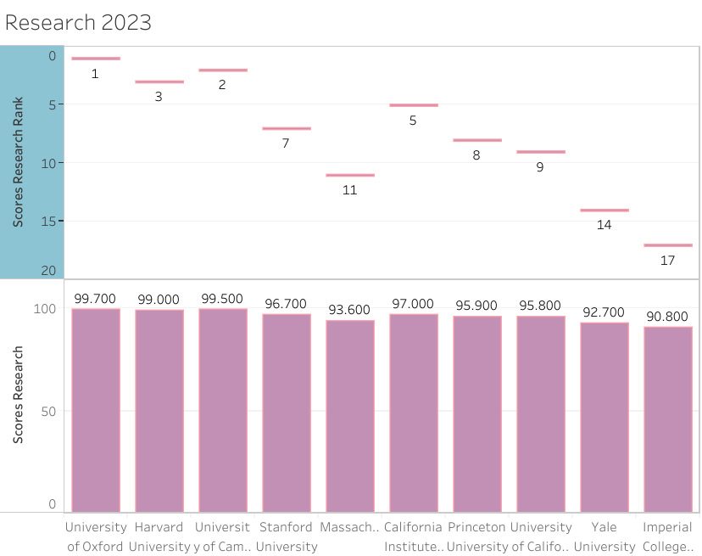
How Did TOP 10 Overall Rank: Research
United States:
Harvard University – 3rd
Stanford University – 7th
Massachusetts – 11th
California institute of Tech – 5th
Princeton University – 8th
University of California – 9th
Yale University – 14th
United Kingdom:
University of Oxford – 1st
University of Cambridge – 2nd
Imperial College – 17th

Slide 15
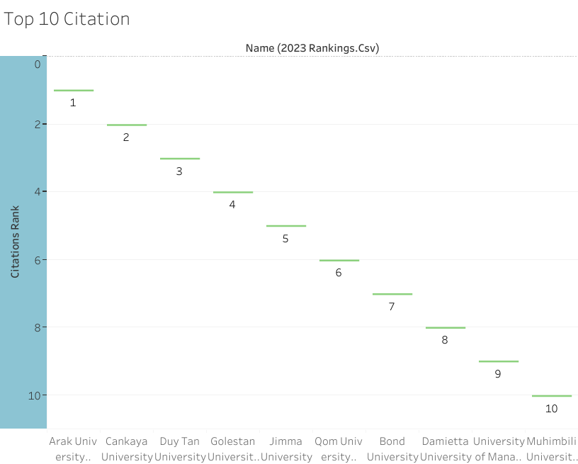
Ranking Criteria: Citations 2023
In the rankings, the research influence of a university is measured by the number of times that work by an academic at that university is cited by another scholar.
The top 10 universities in terms of Research include:
3 Iran
1 Turkey
1 Vietnam
1 Ethiopia
1 Australia
1 Egypt
1 Pakistan
1 Tanzania
Majority of these universities are old, medical sciences universities

Slide 16
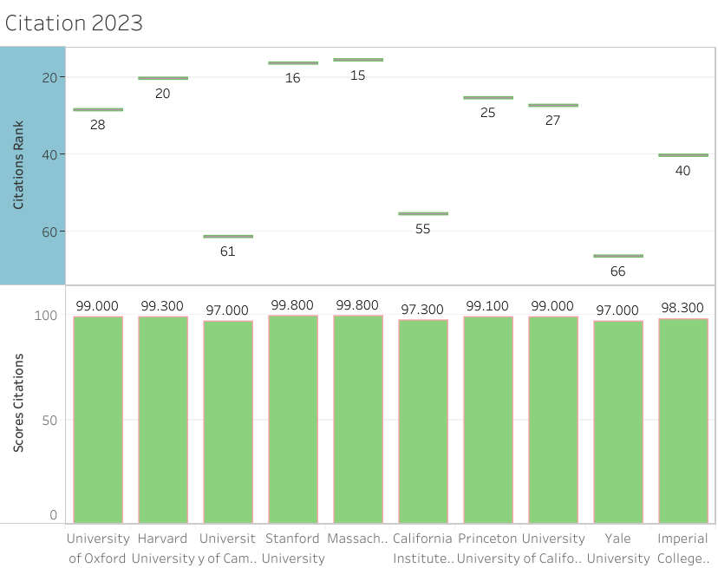
How Did TOP 10 Overall Rank: Citation
United States:
Harvard University – 20th
Stanford University – 16th
Massachusetts – 15th
California institute of Tech – 55th
Princeton University – 25th
University of California – 27th
Yale University – 66th
United Kingdom:
University of Oxford – 28th
University of Cambridge – 61st
Imperial College – 40th

Slide 17
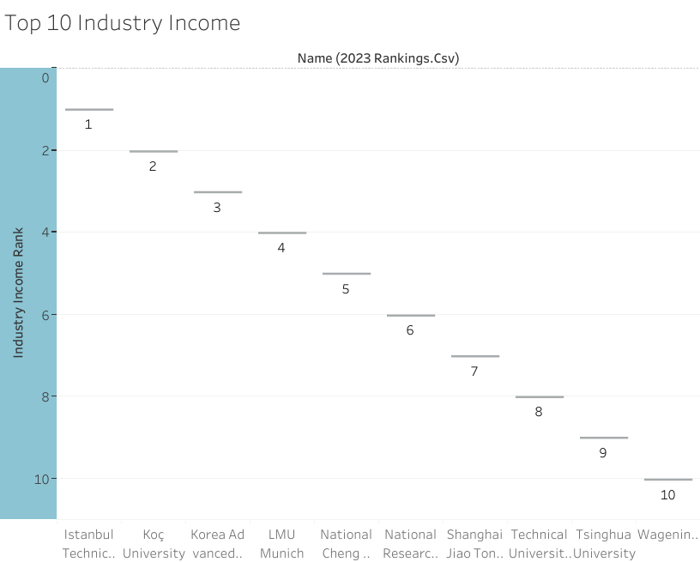
Ranking Criteria: Industry Income 2023
It indicates the commercial impact of an institution’s research, which is itself a reflection of the industrial value of the research.
The top 10 universities in terms of Research include:
2 Turkey
1 South Korea
2 Germany
1 Taiwan
2 China
1 Russia
1 Netherlands
Majority of these universities of science, engineering, business and technology

Slide 18
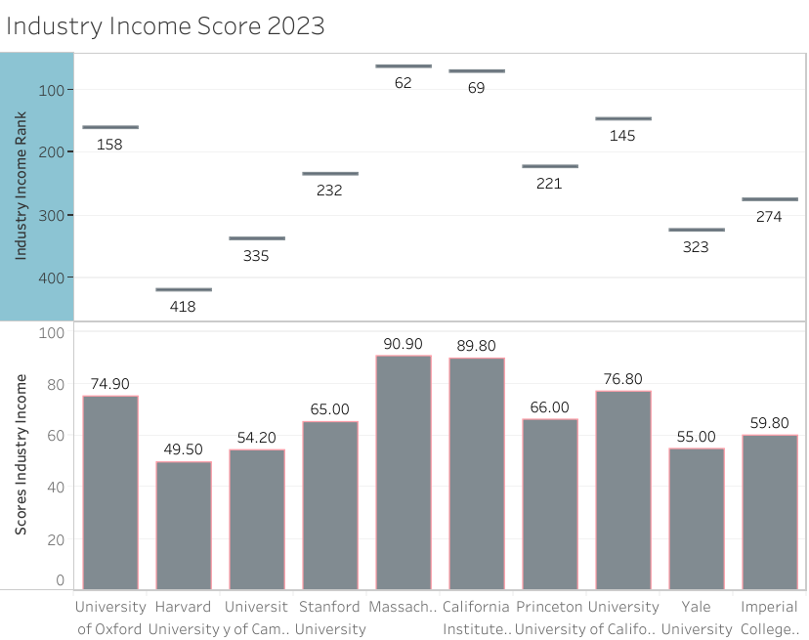
How Did TOP 10 Overall Rank: Industry Income
United States:
Harvard University – 418th
Stanford University – 232nd
Massachusetts – 62nd
California institute of Tech – 69th
Princeton University – 221st
University of California – 145th
Yale University – 323rd
United Kingdom:
University of Oxford – 158th
University of Cambridge – 335th
Imperial College – 274th

Slide 19
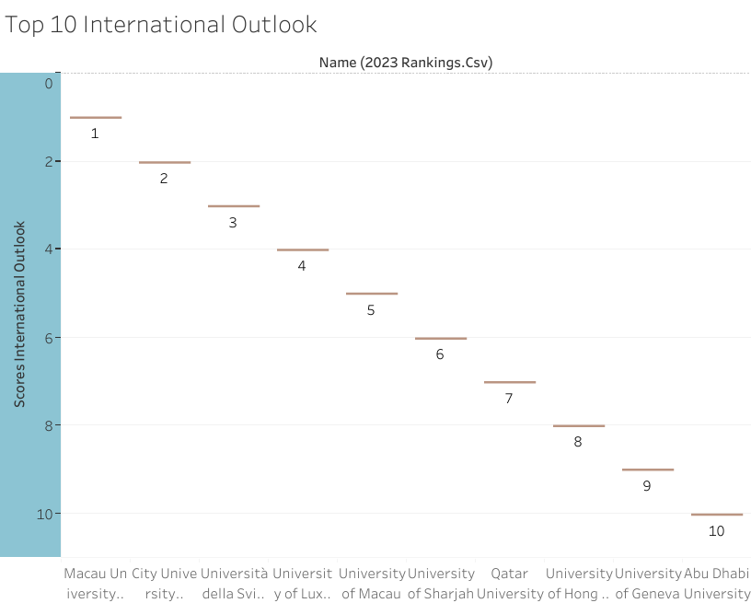
Ranking Criteria: International Outlook 2023
International outlook is therefore a mark of a top institution, relevant both to international and domestic students.
The top 10 universities in terms of Research include:
2 Macao
2 Hong Kong
2 Switzerland
1 Luxembourg
2 UAE
1 Qatar
-

Slide 20
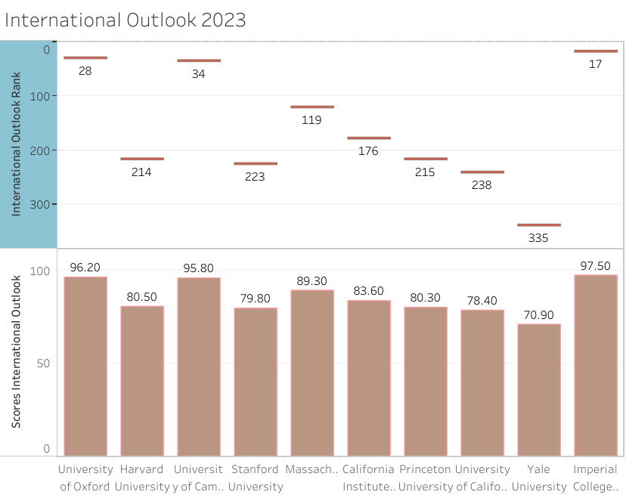
How Did TOP 10 Overall Rank: International Outlook
United States:
Harvard University – 214th
Stanford University – 223rd
Massachusetts – 119th
California institute of Tech – 176th
Princeton University – 215th
University of California – 238th
Yale University – 335th
United Kingdom:
University of Oxford – 28th
University of Cambridge – 34th
Imperial College – 17th

Slide 21
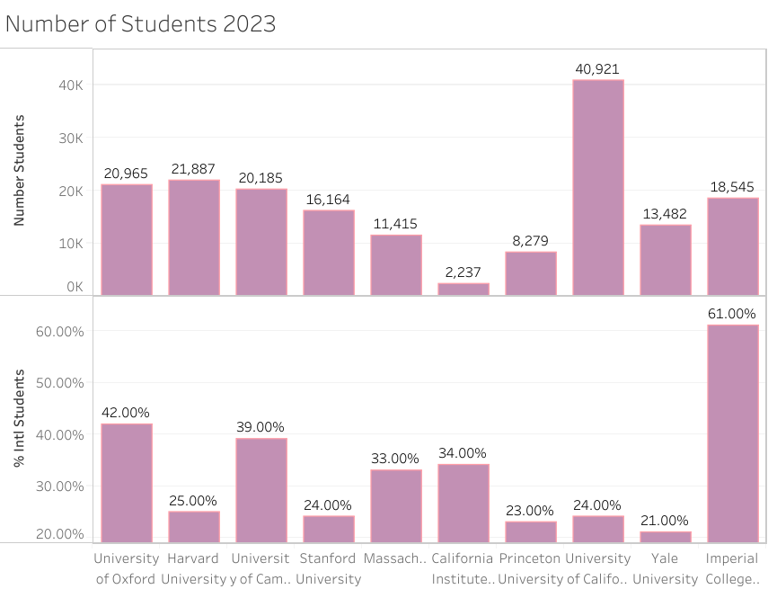
Students and International Students
United States:
Have a relatively lower percentage of international students
United Kingdom:
- Has a relatively high percentage of international students

Slide 22
Conclusion
There is no doubt, Ranking is not about quantity but quality
The best Universities come from the UK and US
Universities in UK and US have a good Teaching and Research Rankings
Nonetheless, The Old, medical universities in the Middle east and Africa are no match for the best universities in terms of Citation.
Universities that have the best research impact are in Europe and Asia
The universities with good international outlook comes from Qatar, UAE, Luxembourg, Switzerland, Hong Kong and Macau
UK looks more welcoming/appealing to International students than US

